Slide 1




Soledad Romero,
Sophie Armstrong
Grace Clark,
Cristina Maya,
Alyana Nelson

Slide 2

What is Wearable Orchestra?
Wearable Orchestra is a wearable interactive-immersive technology prototype that allows one or multiple individuals to express themselves through light and sound variations in relation to their bodily movements. The wearable will take in accelerometer data from the user’s/users’ movements and modulate sound and light based on this data. Our wearable comments on the intersection of the body and technology and what future designs will look, feel, and sound like.

Slide 3

Wearable Orchestra - Prototype
Wearable Orchestra - Final Design
The prototype consists of an armband that will have a circuit playground and speaker attached to it. The circuit playground will be connected to the computer, and as the wearer moves, it will make modulated sound.
We plan to have a bolero, two legwarmers, and a headband with one M5 stick per piece. All M5 Sticks will be programmed with working Max Patches that will be implemented into VCV Rack so that all of them can make sound at once. We will also have a performance planned for a specific time during the capstone showcase.

Slide 4

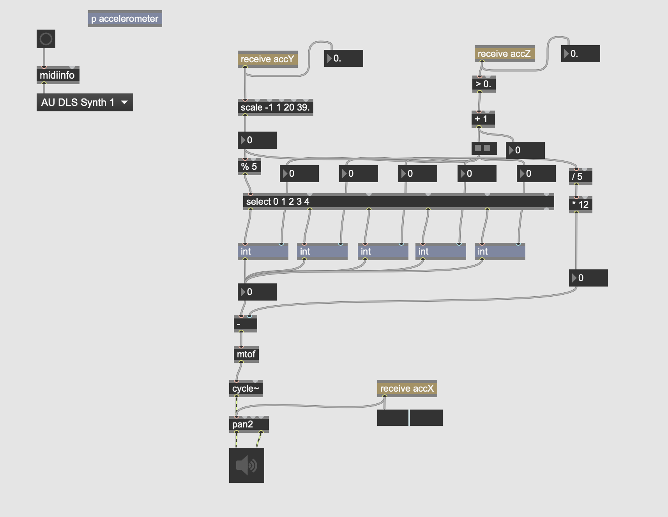
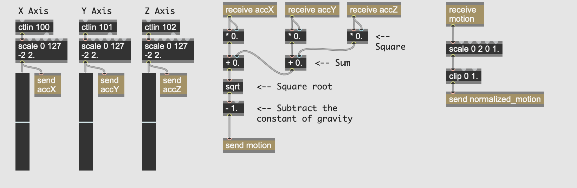
Max Patch Sketches

Slide 5
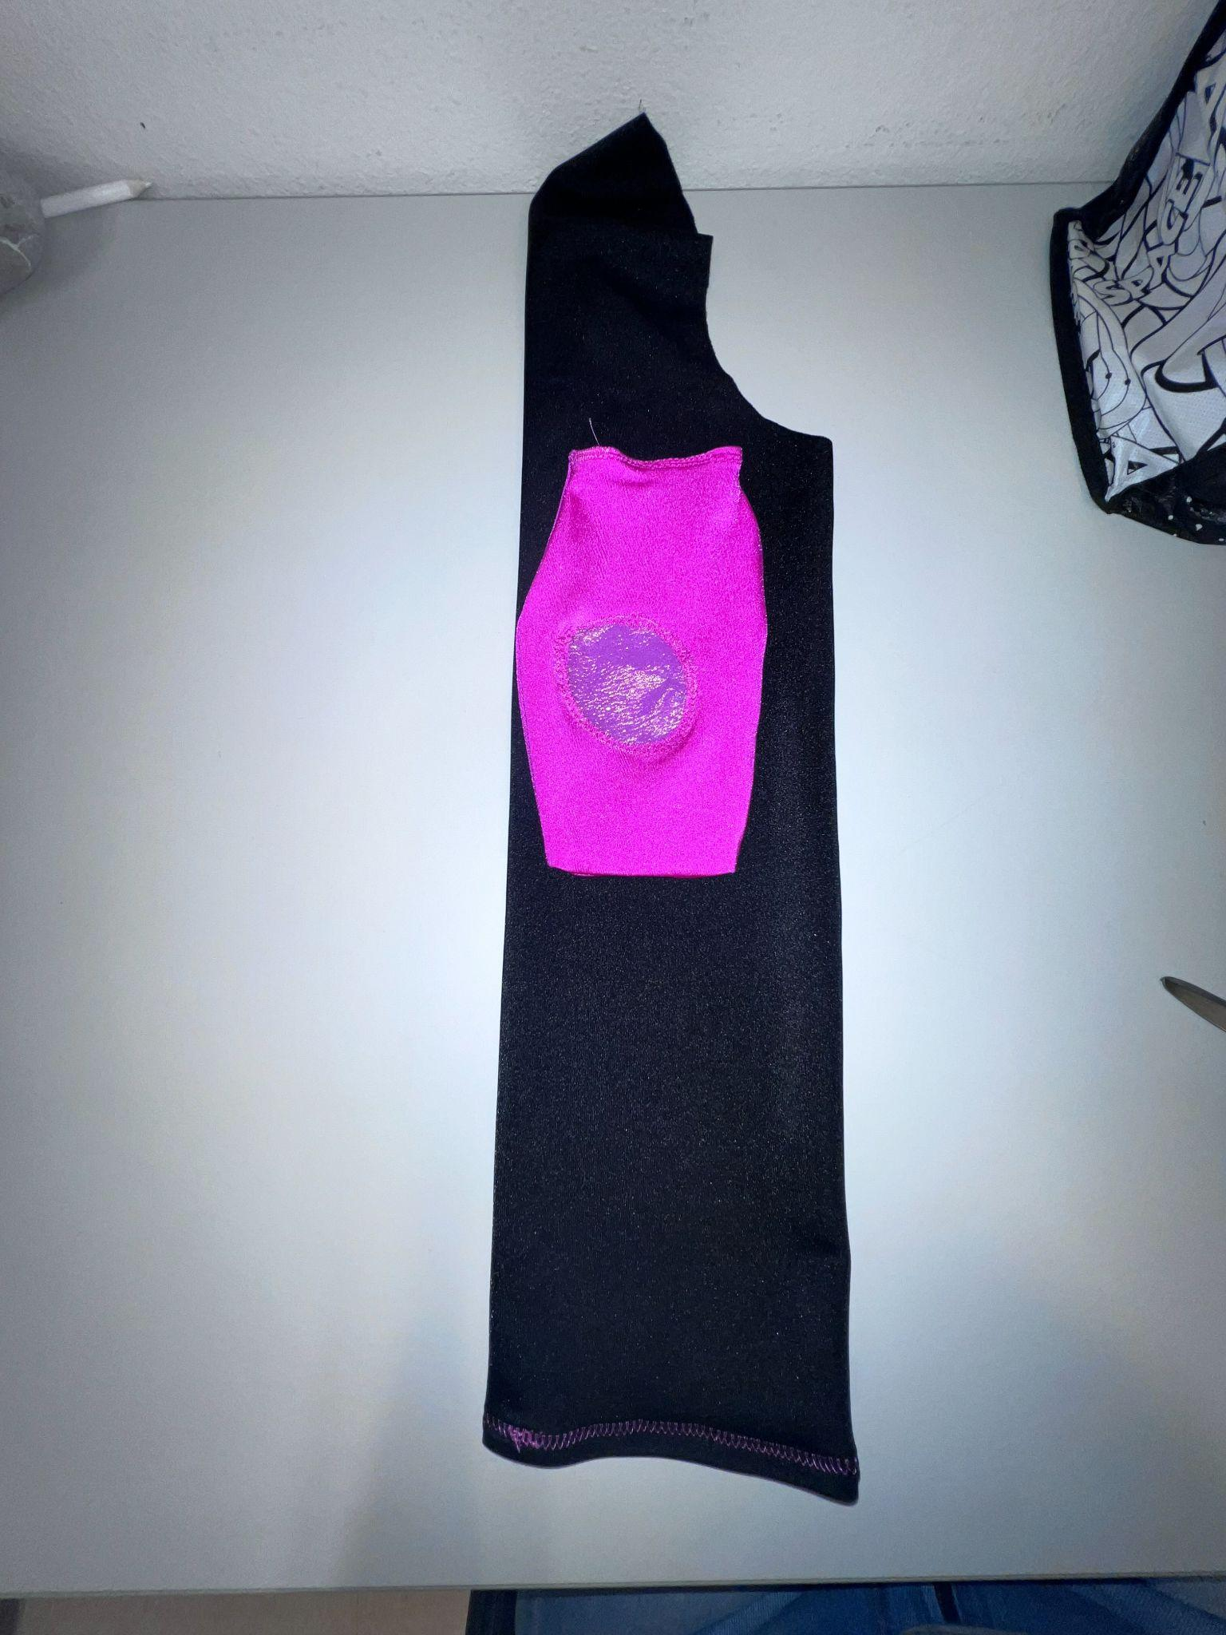
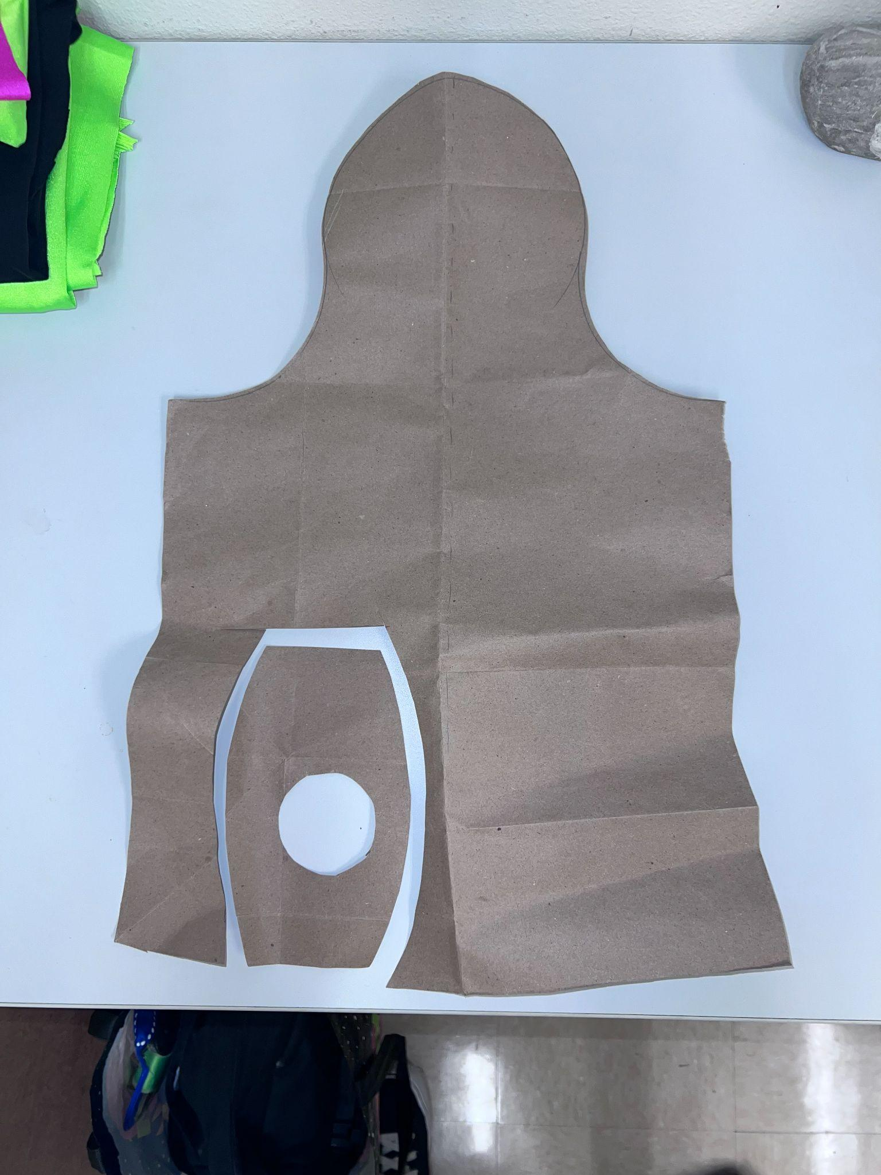
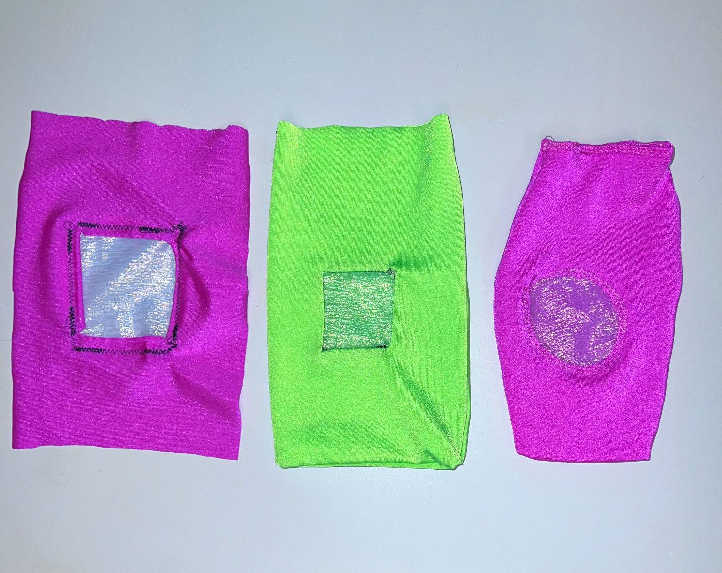
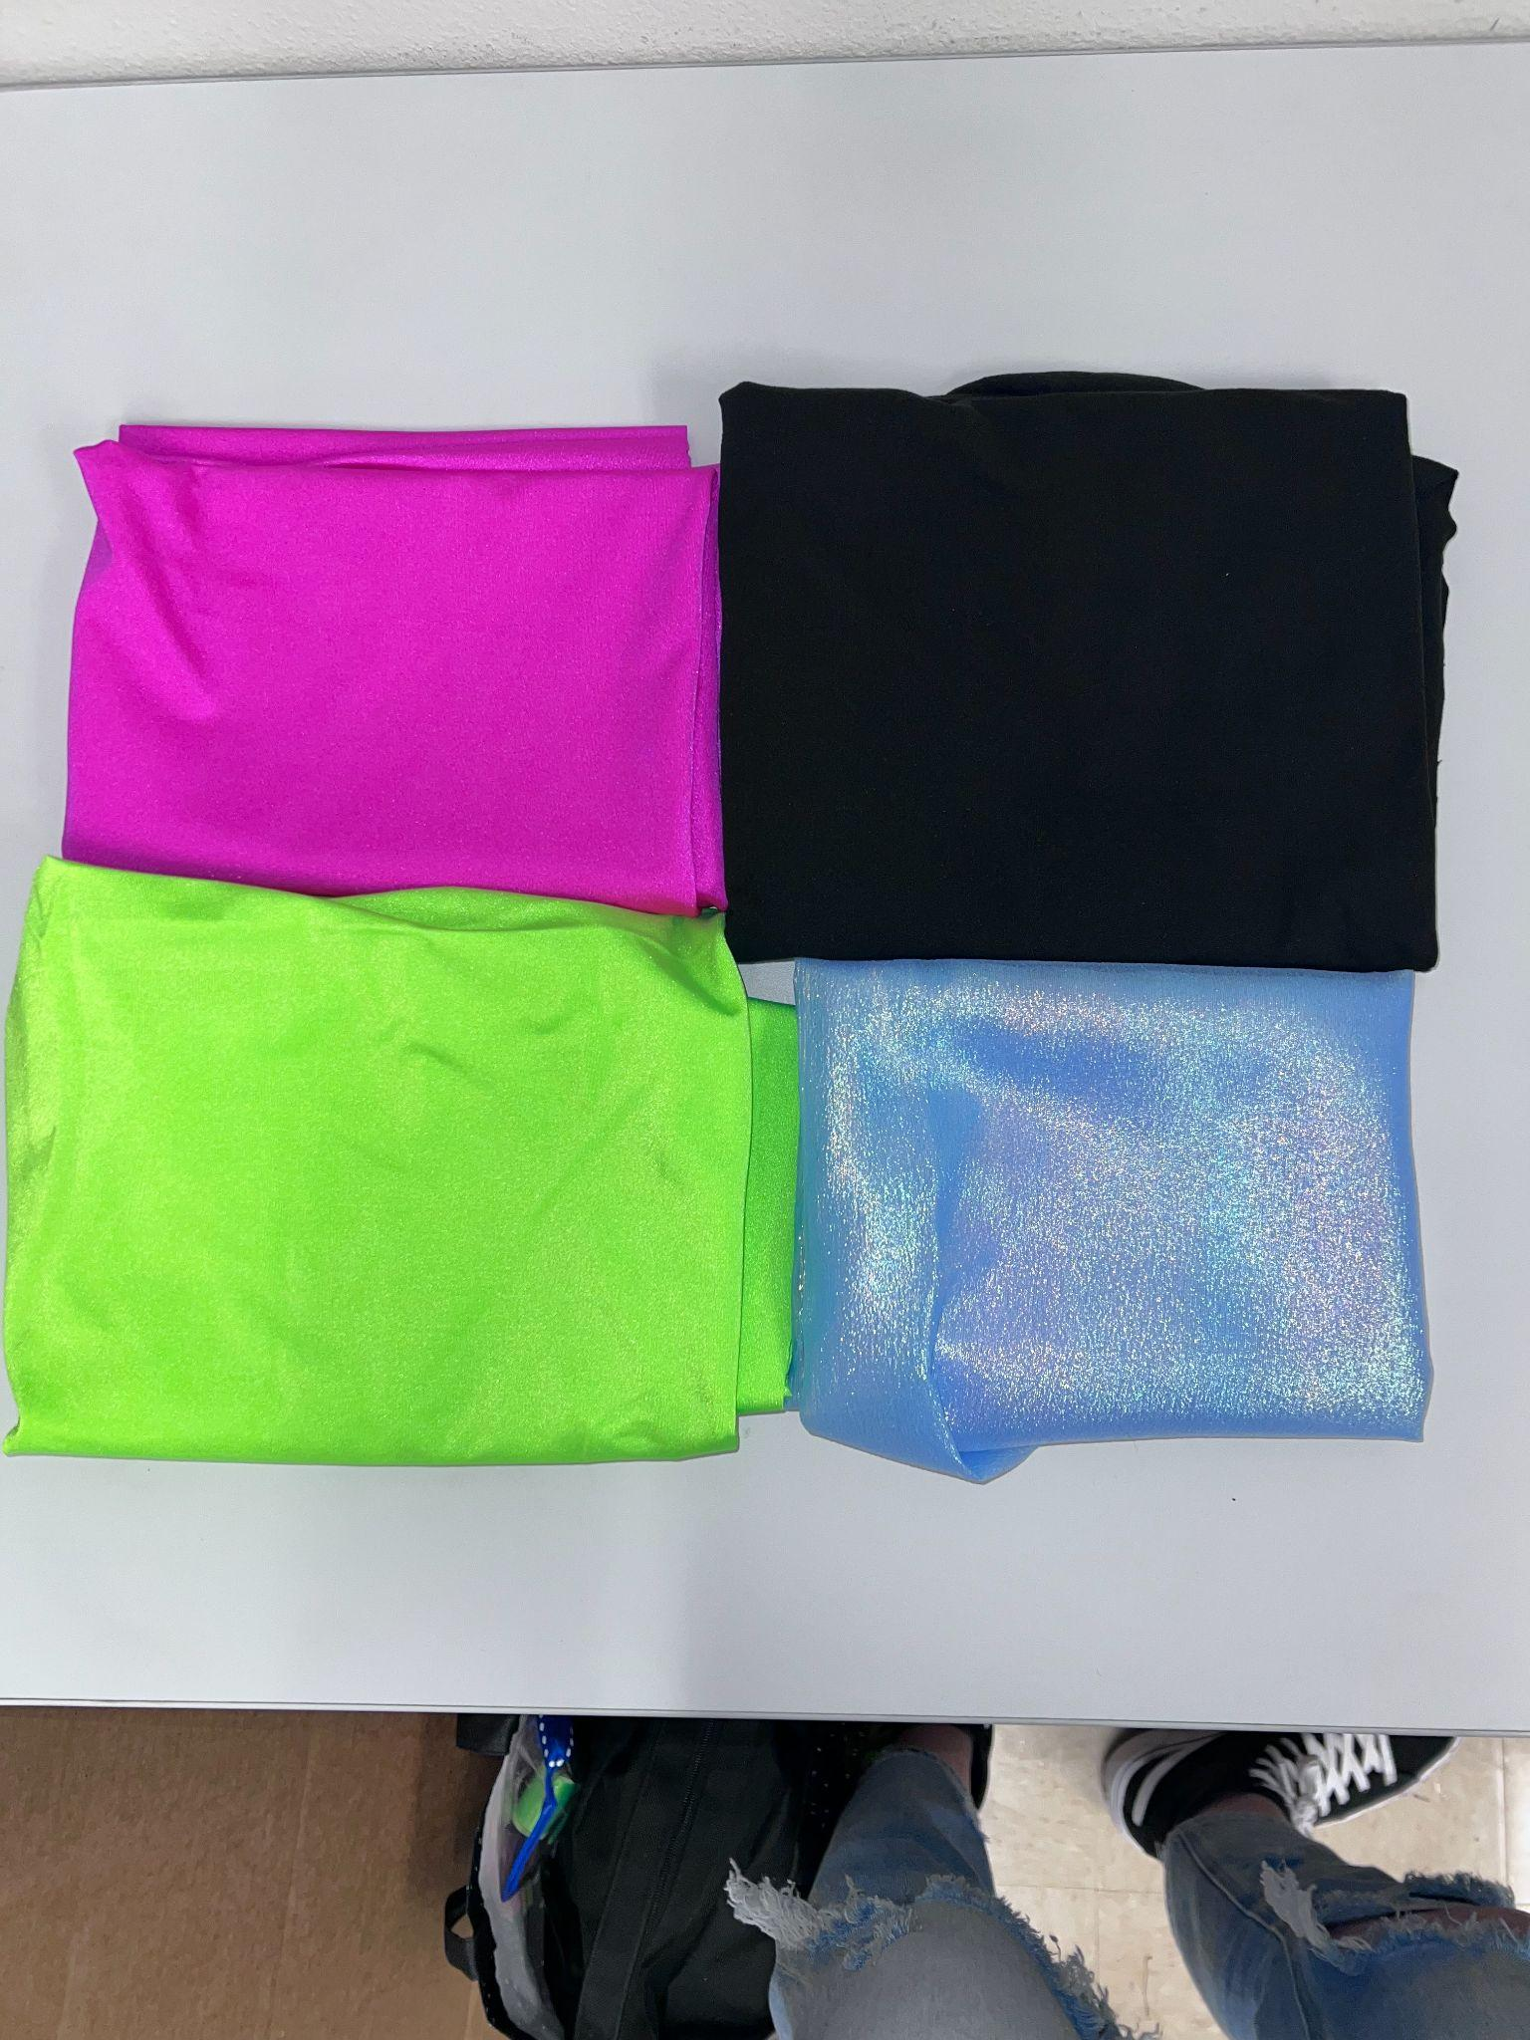
Process Photos

Slide 6

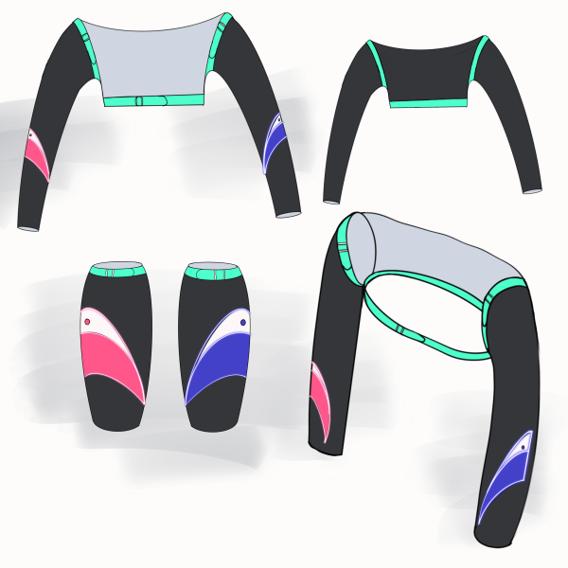
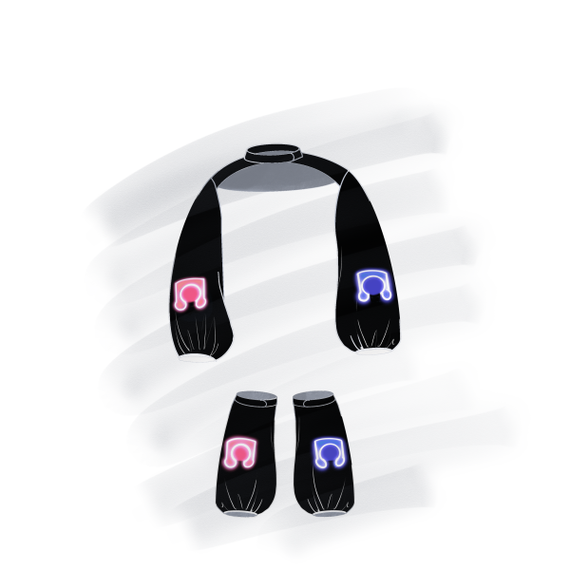
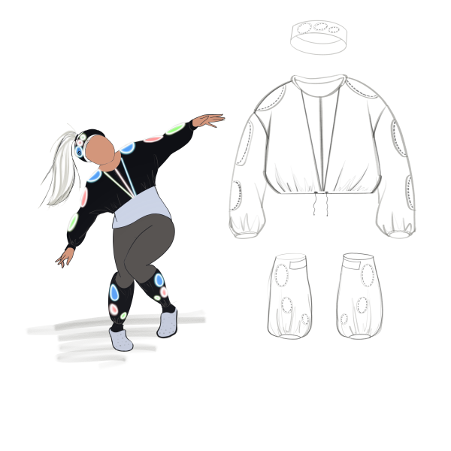
Final Design Sketches
Bringing back “Bolero jacket” & “leg warmers”
Pockets or sewn shapes will hold devices
Straps / adjustable material for customization
Illumination (thread or device) will be visible

